Slide 1
Retail Sales Analysis
This presentation provides a comprehensive analysis of sales performance, customer demographics, and profitability across various product categories. The insights are derived from detailed queries and findings related to customer behaviour, sales trends, and category-wise contributions
The objective of this project is to conduct Exploratory Data Analysis (EDA) to understand consumer behavior and evaluate product category performance. This involves analyzing total sales, customer demographics (age group and gender), and profitability metrics. Through techniques such as segmentation analysis, trend detection, and data visualization, the goal is to uncover actionable insights that support data-driven decision-making and strategic business improvements.

Slide 2
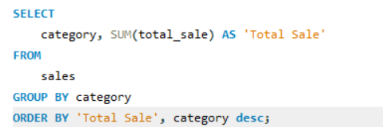
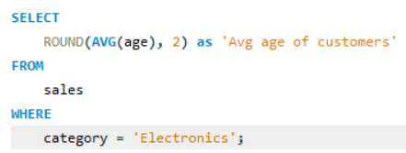
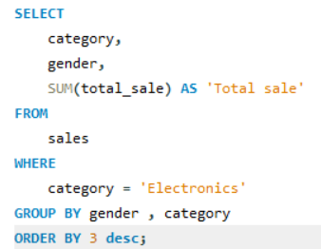
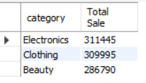
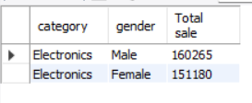

Total Sales by Category
Gender contribution to Electronics Category
Average Age of customers in the Electronics Category

Slide 3
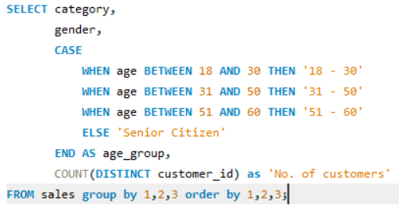
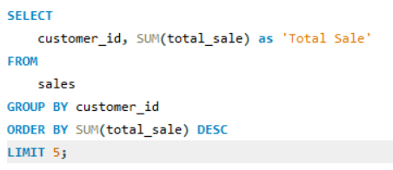
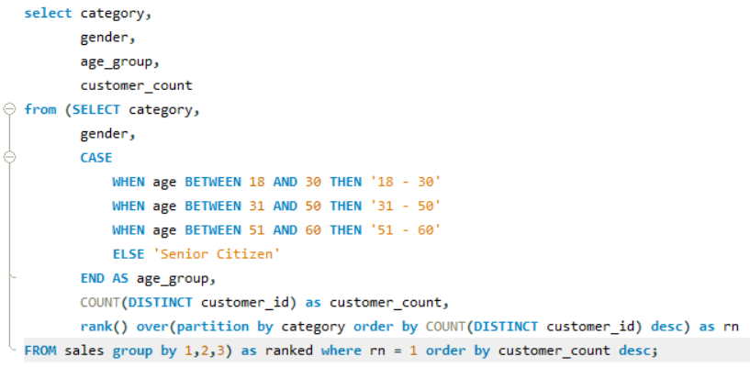
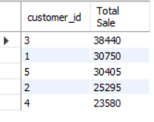
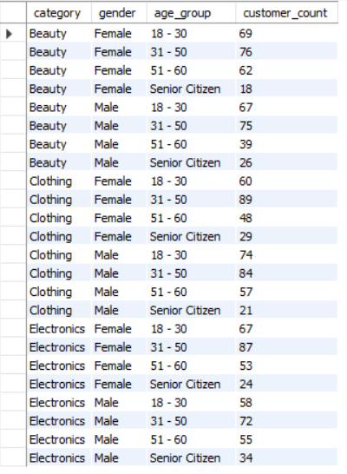
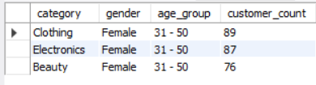
Top 5 Customers by Sales
Customer count by Category, Gender & Age Group
Highest Customer count by Category, Gender & Age Group

Slide 4
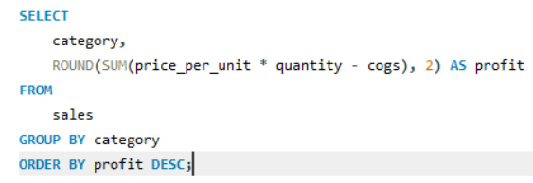
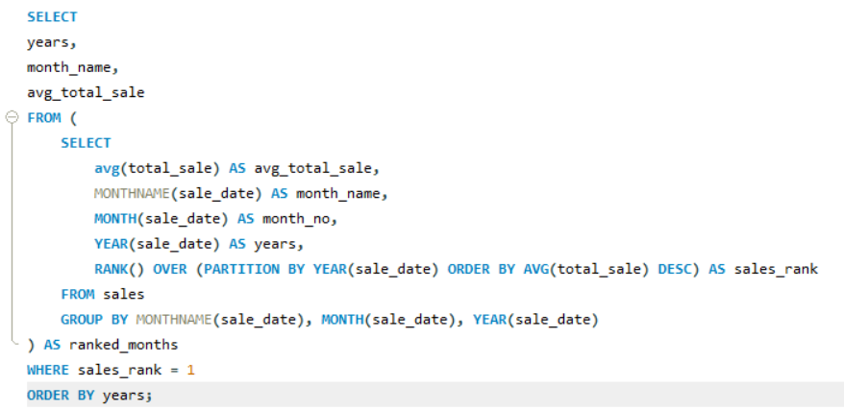
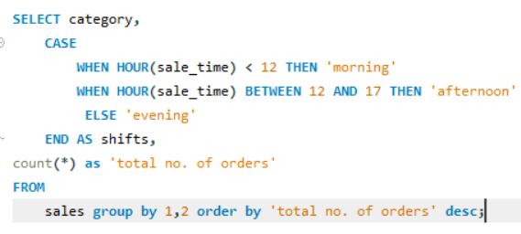
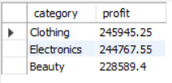

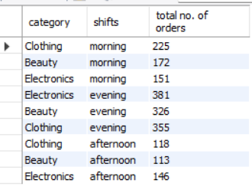
Yearly Highest Average Total Sales
Number of Transactions by Category and Shift Timing
Profit Analysis by Category

Slide 5
Analysis and Insights
Electronics Category Dominance The Electronics category recorded the highest total sales among all product categories.
Customer Demographics in Electronics The average age of customers purchasing electronics is approximately 41.60 years, indicating a mature customer base.
Gender Contribution to Electronics Sales Male customers contributed a higher total sales amount in the Electronics category compared to female customers.
Top Performing Customers The analysis identified the top 5 customers based on their total purchase value.
Age Group Distribution Across Categories For all three categories, female customers aged between 31 and 50 represent the highest count, with Clothing being the most preferred category within this group.
Seasonal Sales Trends The highest average total sales were observed in July (2022) and February (2023), indicating peak sales periods.
Shift-wise Order Distribution Across all categories, the morning shift sees the highest number of orders, followed by the evening, with the afternoon shift having the least.
Profitability by Category The Clothing category generated the highest profit.

Slide 6
Recommendations
Electronics has the highest total sales, consider allocating more marketing budget to this category. Highlight popular products and offer targeted promotions to further boost sales.
With the average age of electronics customers being around 41.60 years, tailor campaigns and product messaging to appeal to middle-aged consumers, especially those in the 31–50 age range.
As male customers contribute more to electronics sales, develop male-oriented product bundles or loyalty programs. For categories where females dominate (like Clothing), create campaigns that resonate with their preferences.
Engage the top 5 customers with exclusive offers, early access to new products, or personalized communication to retain and grow their loyalty.
Since Clothing generates the highest profit, explore expanding product lines, improving inventory management, and enhancing customer experience in this category.
Capitalize on peak months like July (2022) and February (2023) by planning seasonal promotions, and product launches during these periods.
With morning shifts showing the highest order volume, ensure adequate staffing, inventory availability, and system readiness during these hours to maximize efficiency and customer satisfaction.

